Slide 1
CERDIT CARD DEFAULT PREDICTION
USING MACHINE LEARNING

Slide 2

PROBLEM STATEMENT
Financial threats are displaying a trend about the credit risk of commercial banks as the incredible improvement in the financial industry has arisen.
In this way, one of the biggest threats faced by commercial banks is the risk prediction of credit clients.
The goal is to predict the probability of credit default based on credit card owner’s characteristics and payment history.
PURPOSE OF PROJECT:
Aims to compare the prediction accuracy for the newer developed deep learning methods against with the
conventional machine learning based on the financial information of the credit card holders.
Objective of this framework intended to extract useful features from cardholder data, and applied the artificial intelligence
techniques to assist financial institutions to reduce their risk of credit card default.

Slide 3
APPROACH OVERVIEW
How it works:
Data cleaning
Understand the dataset and clean
Data Exploration
Graphical and Statistical
Predictive Modelling
Machine Learning models

Slide 4
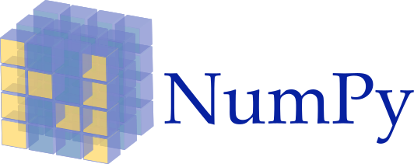




Tools Used
Machine Learning Models
Logistic regression
KNN
Random Forest Classifier
Decision Tree Classifier

Slide 5
Data Acquisition
1
Default payments of credit clients in Taiwan from 2005
2
Real dataset of 30,000 customers. Usage of 6 months from age group of 20-79.
No credit score or credit history
3
the personal information and repayment details of the cardholder were used to trace the consumer behavior for the predictive models.
Original Source: UCI Machine Learning Repository*

Slide 6
Dataset Information
ID: ID of each client ● LIMIT_BAL: Amount of given credit in NT dollars (includes individual and family/supplementary credit ● SEX: Gender (1=male, 2=female) ● EDUCATION: (1=graduate school, 2=university, 3=high school, 4=others, 5=unknown, 6=unknown) ● MARRIAGE: Marital status (1=married, 2=single, 3=others) ● AGE: Age in years ● PAY_0: Repayment status in September, 2005 (-1=pay duly, 1=payment delay for one month, 2=payment delay for two months, ... 8=payment delay for eight months, 9=payment delay for nine months and above) ● PAY_2: Repayment status in August, 2005 (scale same as above) ● PAY_3: Repayment status in July, 2005 (scale same as above) ● PAY_4: Repayment status in June, 2005 (scale same as above) ● PAY_5: Repayment status in May, 2005 (scale same as above) | ● PAY_6: Repayment status in April, 2005 (scale same as above) ● BILL_AMT1: Amount of bill statement in September, 2005 (NT dollar) ● BILL_AMT2: Amount of bill statement in August, 2005 (NT dollar) ● BILL_AMT3: Amount of bill statement in July, 2005 (NT dollar) ● BILL_AMT4: Amount of bill statement in June, 2005 (NT dollar) ● BILL_AMT5: Amount of bill statement in May, 2005 (NT dollar) ● BILL_AMT6: Amount of bill statement in April, 2005 (NT dollar) ● PAY_AMT1: Amount of previous payment in September, 2005 (NT dollar) ● PAY_AMT2: Amount of previous payment in August, 2005 (NT dollar) ● PAY_AMT3: Amount of previous payment in July, 2005 (NT dollar) ● PAY_AMT4: Amount of previous payment in June, 2005 (NT dollar) ● PAY_AMT5: Amount of previous payment in May, 2005 (NT dollar) ● PAY_AMT6: Amount of previous payment in April, 2005 (NT dollar) ● default.payment.next.month: Default payment (1=yes, 0=no)

Slide 7
Exploratory Data Analysis
EDA is a process of performing some initial investigations on the dataset to discover the structure and the content of the given dataset.
EDA is where we get the basic understanding of the data in hand which then helps us in the further process of Data Cleaning & Data Preparation.
Let’s see in table what all steps to be followed:
Table of Contents
Introducing the Dataset | Handling Duplicates
Importing the python libraries | Handling Outliers
Loading the Dataset | Handling Missing Values
Structured Based Data Exploration | Univariate and Bivariate Analysis
1

Slide 8
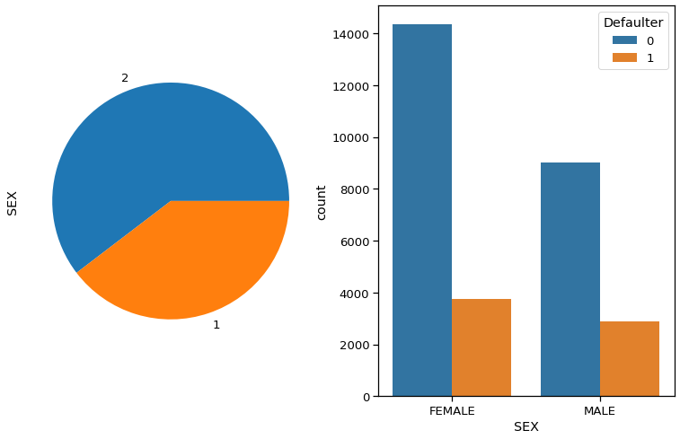
Gender Variable
26% of females and
30% of males have payment default
1
There are more females credit card holder, so no. of defaulter have high proportion of females.
2

Slide 9
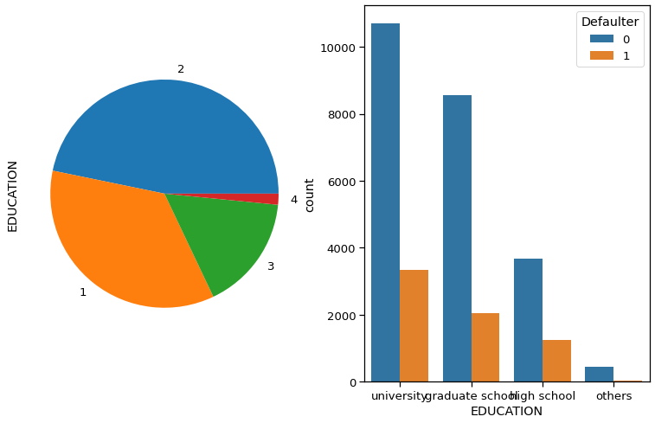
Education Variable
Higher education level, Lower default risk.
1
No. of defaulters have a higher proportion of educated people (graduate school and university)
2

Slide 10
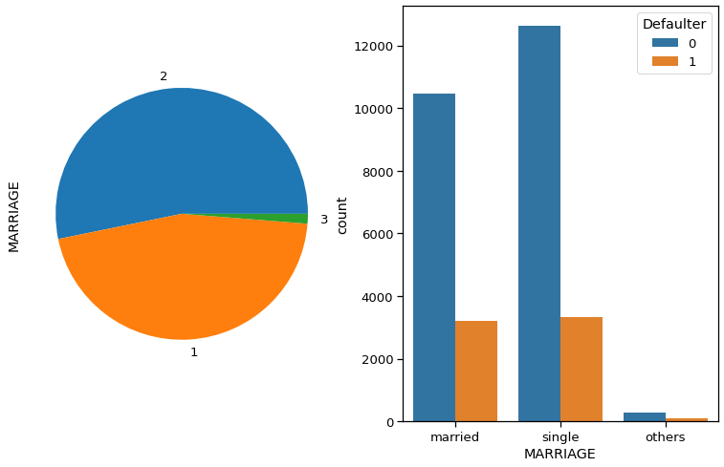
Marital Status Variable
No. of defaulters have a higher proportion of Singles.
1

Slide 11
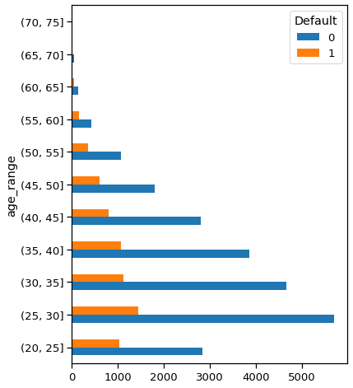
Age Variable
1
40-50: Lowest risk
<30 or >50: Risk increases
No. of defaulters have a higher proportion at age group of 25 to 30.
2

Slide 12
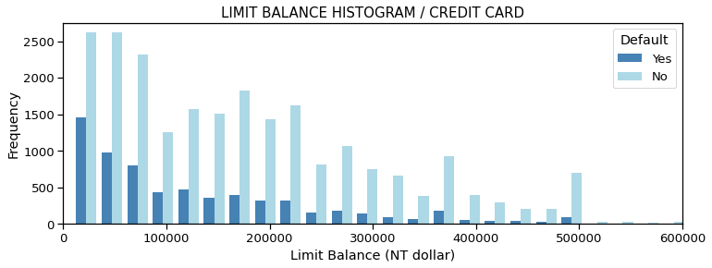
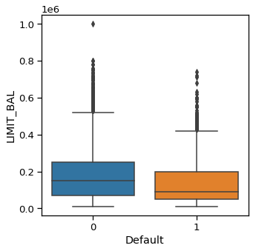
Limit Balance Variable
Higher credit limits,
Lower default risk.
1
2
40-50: Lowest risk
<30 or >50: Risk increases

Slide 13
Modelling Overview
Define
problem
Supervised Learning/binary classification
Imbalanced classes
78% non-default vs 22% default
Models
Applied
Logistic regression/Random Forest/Decision Tree classifier/KNN

Slide 14
Modelling Overview
Data Pre-processing
Feature selection and engineering
Filling and tuning
Start with default model parameters
Model Evaluation
Models testing/comparing/predicting.
Split dataset into Train and Test data
Training data rescaling
Measure ROC_AUC on trained data

Slide 15
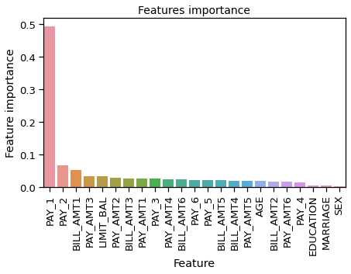
Feature Importance
1
2
Choose Smart Lookup, and notice that results are contextual for that phrase, not Microsoft Office apps.
3
Just for fun, try Smart Lookup again by right-clicking in the word Office in Step 2.

Slide 16
Model comparisons
Models | Accuracy
Logistic Regression | 0.7795
Decision Tree | 0.8183
SVM | 0.8199
Neural Network | 0.8096
KNN | 0.7895
Random Forest
ADABOOST | 0.8211
Navie Bayes | 0.3848
0.8231

Slide 17
Conclusion
Random forest classifier gives the good precision and recall balance.
Dormant customers also can have default risk.
Higher recall can be achieved if low precision is acceptable.
Model can be served as an aid to human decision.
Suggest output probabilities rather than predictions.
Model can be improved with more data and computational resources.

